Slide 1
Bellabeat Consumer Data
By
Rahul Shankar Iyer

Slide 2
Business Task
To identify trends in the way consumers use smart devices for non Bellabeat products

Slide 3
Data Sources
FitBit Fitness Tracker Data | Kaggle
The above source contains the following datasets, with fitness data from Mid April to Mid May of 2016:
dailyActivity_merged.csv
dailyCalories_merged.csv
dailyIntensities_merged.csv
dailySteps_merged.csv
heartrate_seconds_merged.csv
hourlyCalories_merged.csv
hourlyIntensities_merged.csv
hourlySteps_merged.csv
minuteCaloriesNarrow_merged.csv
minuteCaloriesWide_merged.csv
minuteIntensitiesNarrow_merged.csv
minuteIntensitiesWide_merged.csv
minuteMETsNarrow_merged.csv
minuteSleep_merged.csv
minuteStepsNarrow_merged.csv
minuteStepsWide_merged.csv
sleepDay_merged.csv
weightLogInfo_merged.csv

Slide 4
Data Operations - Using Big Query SQL
All the csv files were uploaded into a database
Given that we were dealing with multiple datasets in this case, we first inspected the schema for each of the tables to find any common columns
‘Id’ was found to be a common column in all the datasets
For the datasets involving daily usage data, the dates were getting inserted with datatypes as ‘date’
With hourly usage and minute wise usage, where the dates also contained timestamps, the dates had to be inserted with type string and converted accordingly for further data operations
For doing analysis on daily data, we compared the columns in each of the daily data tables and made sure that the data types of their columns aligned.

Slide 5
Data Operations - Using R
The following two datasets were uploaded to the R space:
dailyActivity_merged.csv
sleepDay_merged.csv
After uploading these two datasets, we explored the columns present in each table as well as small samples of what kind of data is stored in each of them.
An inspection of the number of observations of both datasets found 940 observations for daily activity and 413 for sleeping pattern

Slide 6
Data Analysis - Using R
There are 33 distinct users in the daily activity dataset and 24 in the sleep datasaet
Some quick summary statistics were then extracted from each of the two datasets, which included minimum value, 1st quartile, median, mean, 3rd quartile and maximum value
We then plotted the below two relationships:
Steps Taken in a Day vs Sedentary Minutes
Total Minutes Asleep vs Total Time in Bed

Slide 7
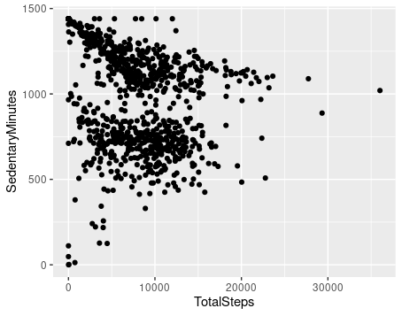
Steps Taken in a Day vs Sedentary Minutes

Slide 8
Steps Taken in a Day vs Sedentary Minutes
From the previous graph, here are the following takeaways:
Except for a few outliers, the number of steps taken by users per day seems to be indirectly proportional to their daily sedentary time
Roughly half of the customers spend between 8-16 hours of sedentary time everyday
Roughly half of the customers spend more than 16 hours of sedentary time everyday
Very few of the users take more than 20000 steps per day
Very few of the users spend less than 8 hours of sedentary time

Slide 9
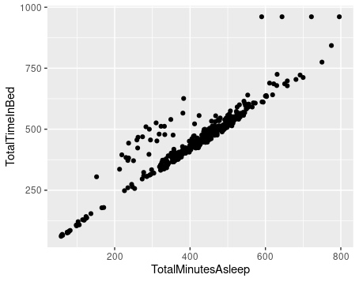
Total Minutes Asleep vs Total Time in Bed

Slide 10
Total Minutes Asleep vs Total Time in Bed
From the previous graph, here are the following takeaways:
The amount of time spent in bed and the actual amount of time for which users are asleep are directly proportional
Most users take roughly 20-30 minutes to fall asleep after lying down in bed
A majority of the users sleep for around 6-8 hours per day

Slide 11
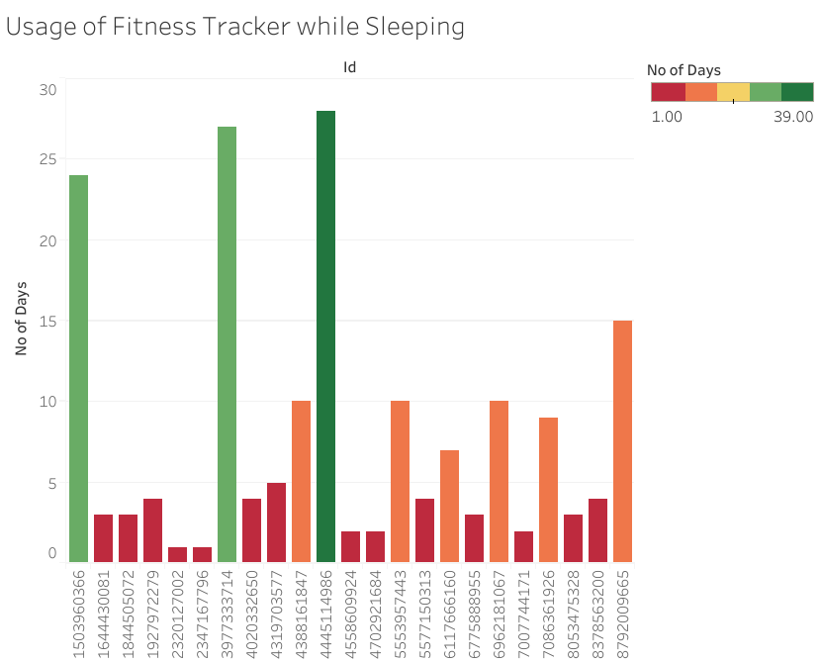
Usage of Fitness Tracker while Sleeping

Slide 12
Usage of Fitness Tracker while Sleeping
From the previous graph, here are the following takeaways:
Out of the 33 users that agreed to share their personal tracker data, 23 of them used their tracker while sleeping
Among the 23 that used their tracker while sleeping, only 3 of the users had used the tracker for more than 20 days of the previous month, 6 of the users had used the tracker between 5-15 days, and 14 had only used it for 5 days or less

Slide 13
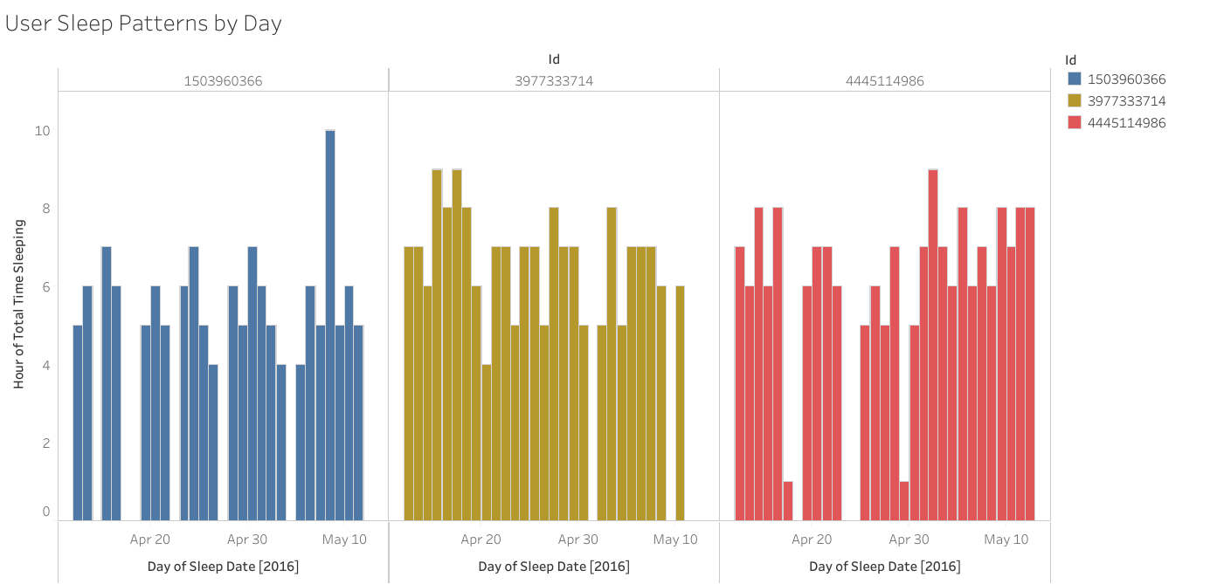
User Sleep Patterns by Day - Frequent Users

Slide 14
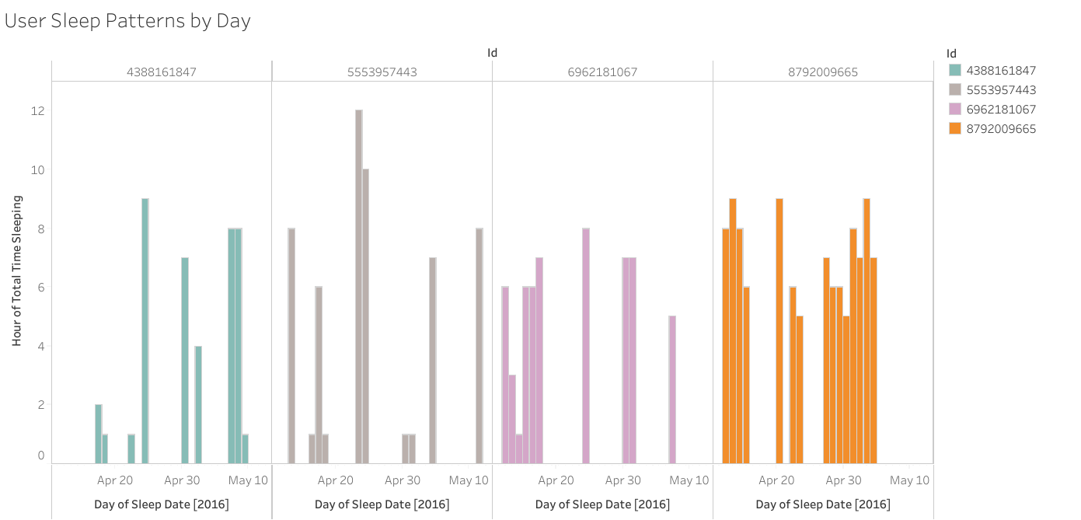
User Sleep Patterns by Day -Moderate Users

Slide 15
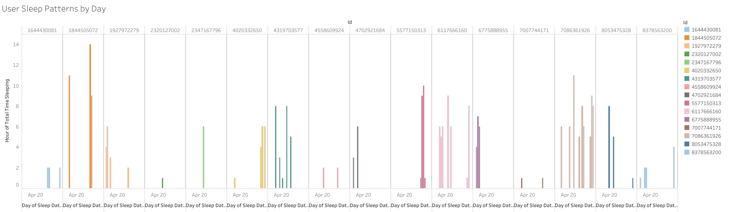
User Sleep Patterns by Day - Infrequent Users

Slide 16
User Sleep Patterns by Day
From the previous three graphs, it can be said that the users who are using the tracker frequently while sleeping probably have more consistent sleep patterns than those who are using it moderately and those who are using it infrequently

Slide 17
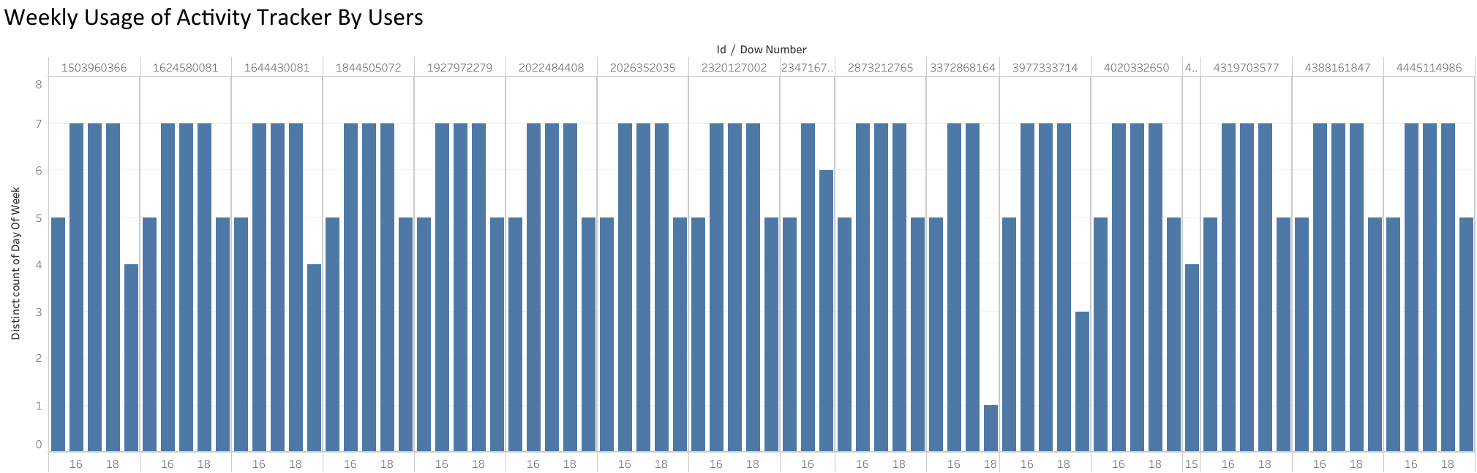
Weekly Usage of Activity Tracker By Users

Slide 18
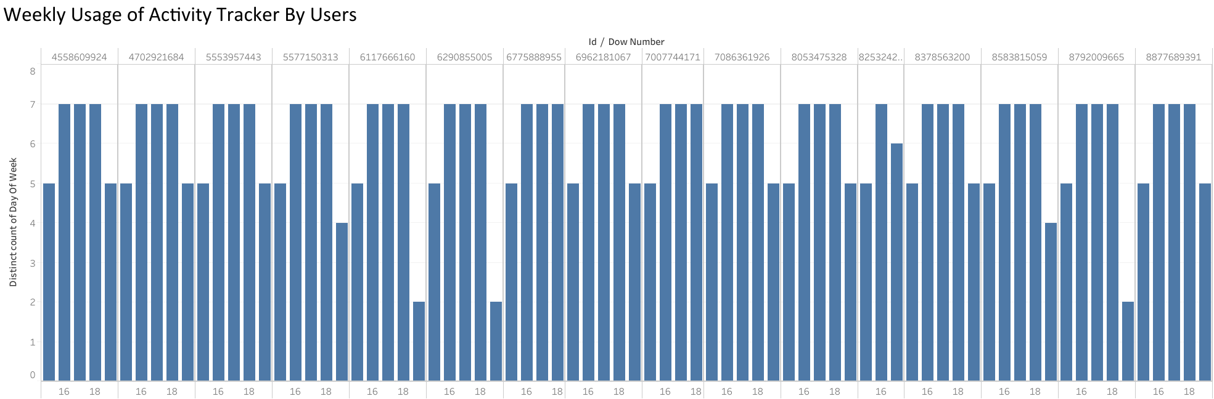
Weekly Usage of Activity Tracker By Users (Contd.)

Slide 19
Daily Usage of Activity Tracker By Users

Slide 20
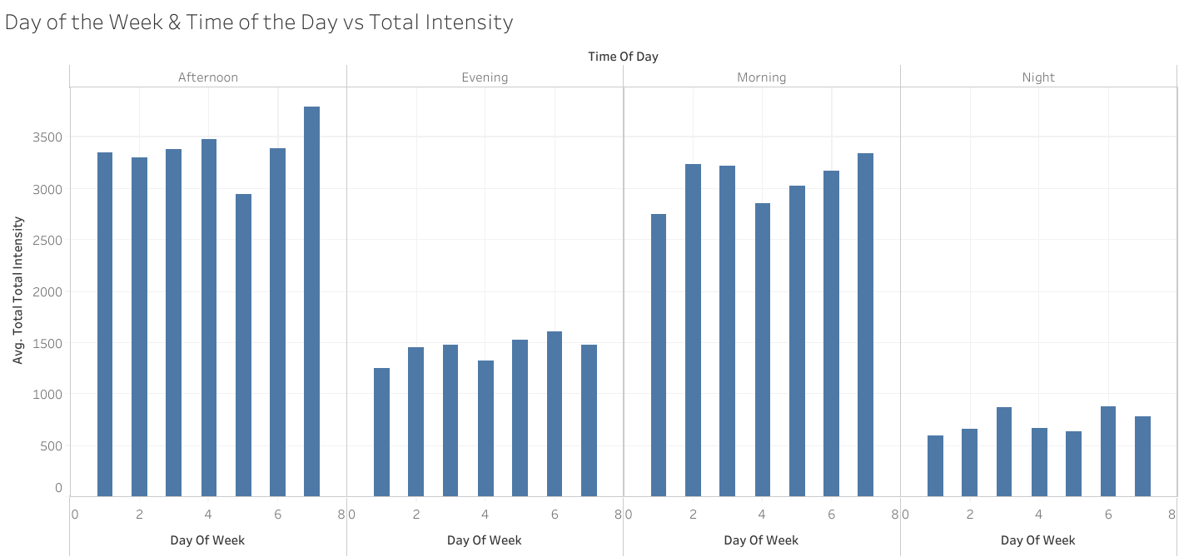
Usage of Activity Tracker

Slide 21
Usage of Activity Tracker
All the 33 users who agreed to share their data used the intensity tracker, out of whom 20 of the users used the tracker on all the days
The more frequently users tracked their activity, their intensity per day was also higher on average
On average, users had higher intensities during the morning and afternoon than the evening and night, regardless of which day of the week it was

Slide 22
Key Findings
More users tend to track data when it comes to their activity, but not their sleep
The fact that sleep time has not been tracked every day shows that many users might not find it convenient to wear a tracking device on their wrists while sleeping

Slide 23
Recommendations
Do more advertising for fitness and having an active lifestyle by sponsoring women’s sporting events as many women who are into fitness are likely to be watchers, followers or athletes in those sports
Have business tie ups with local gyms/memberships
The Bellabeat app can be paired with the phone so that the users can know who is calling them while they’re doing their work out, without having to go to their phone
When measuring sedentary minutes during a day, the Bellabeat app should exclude the time when the user is asleep by pairing with the cellphone through an app. The cellphone measures sleep by taking into account the last activity on the phone to the time set on the alarm

